Slide 1
Logistic Regression
Noble Xavier

Slide 2
Supervised Learning
Regression
  Simple Linear Regression
  Multiple Linear Regression
  Decision Tree
  Random Forest
  Polynomial Regression
Classification
  Logistic regression
  k-nearest neighbour (KNN)
  Naive Bayes (Classifier)
  Support vector machines
  Decision Tree
  Random Forest

Slide 3
LOGISTIC REGRESSION

Slide 4
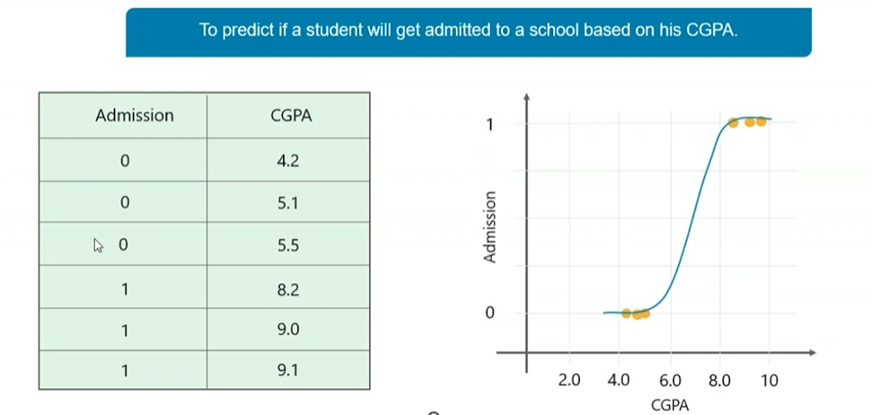
Logistic Regression

Slide 5
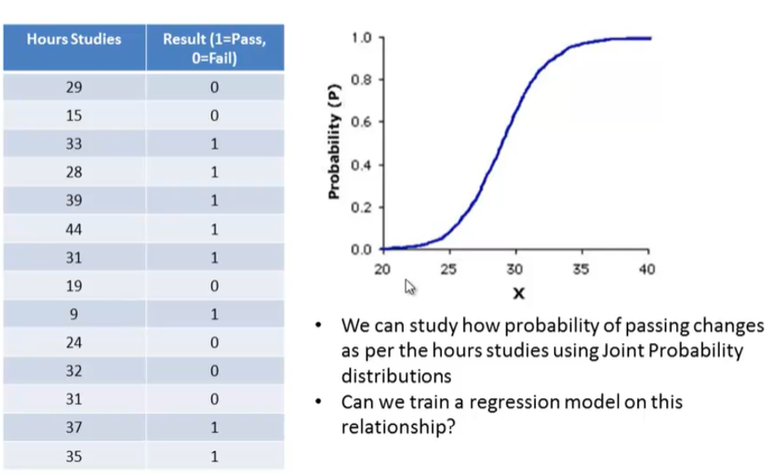
Logistic Regression- Example Hours study and Pass

Slide 6
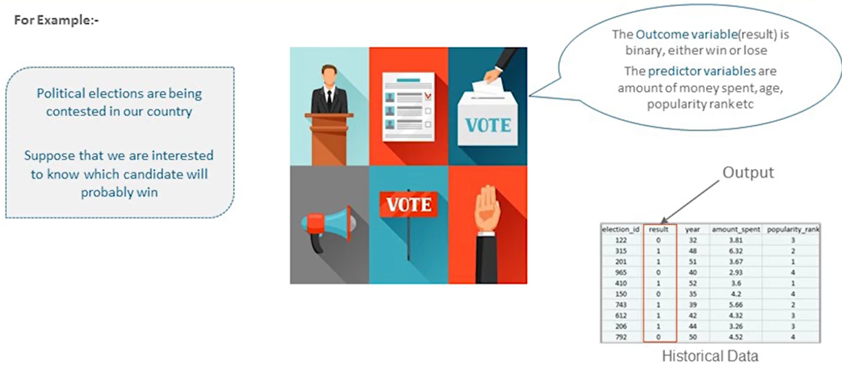
Logistic Regression- Example Election

Slide 7
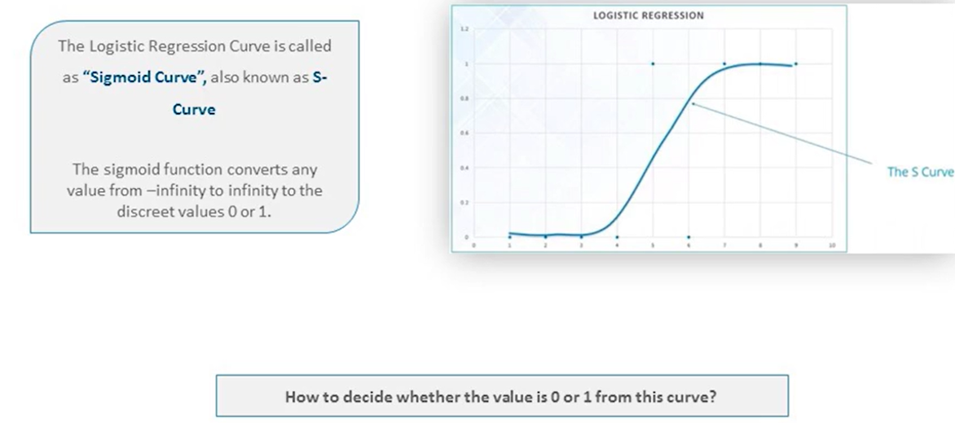
Logistic Regression-Curve

Slide 8
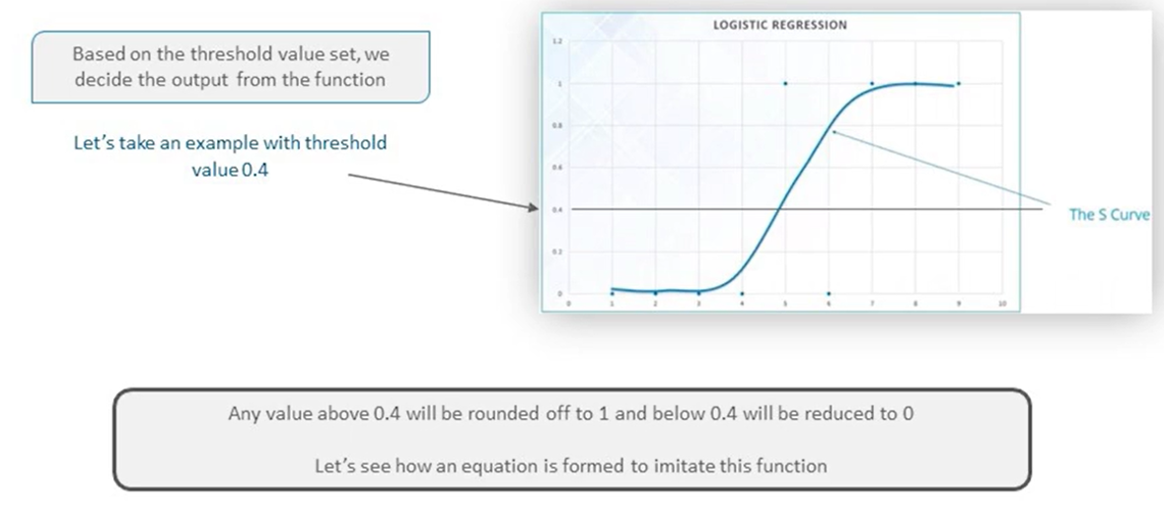
Logistic Regression-Curve

Slide 9
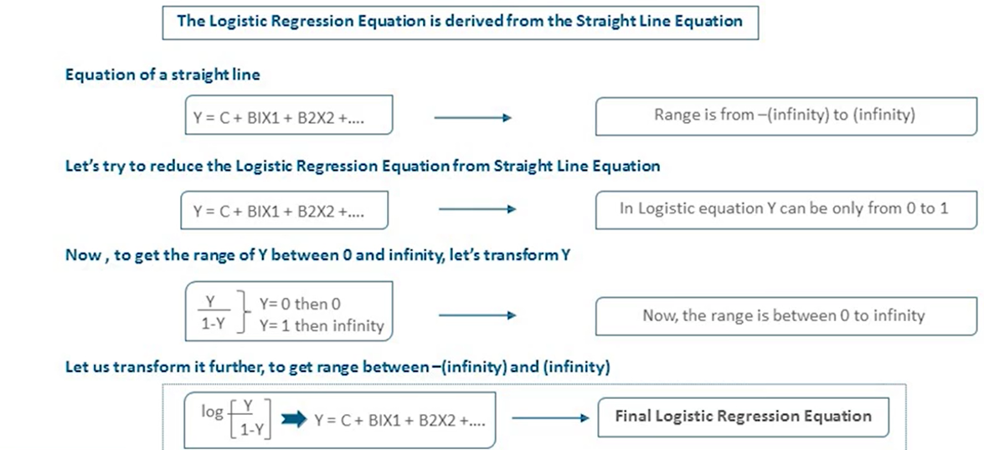
Logistic Regression-Equation

Slide 10
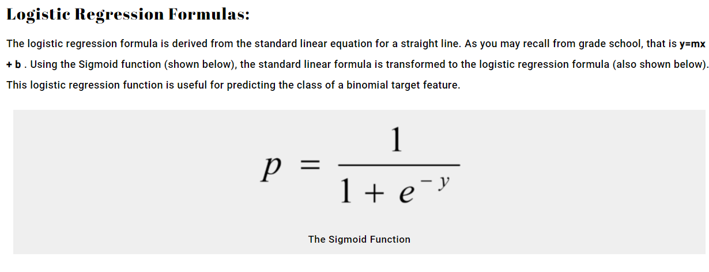
Logistic Regression

Slide 11
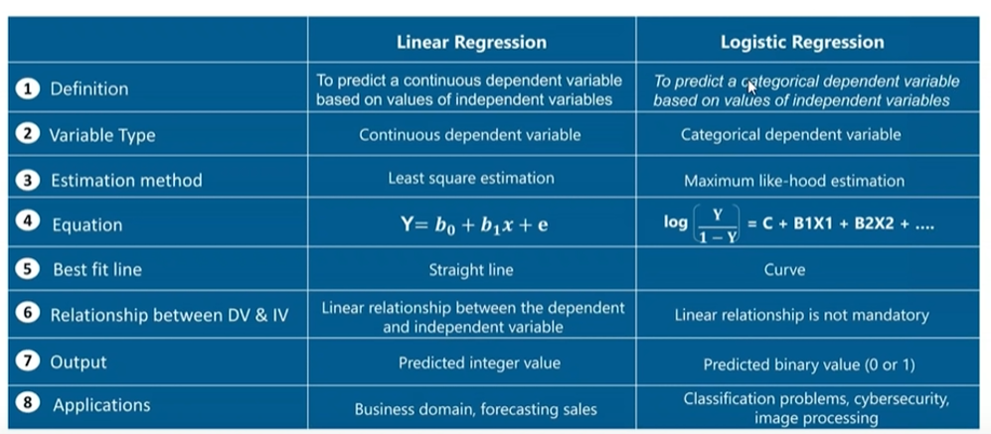
Linear Vs Logistic Regression

